Slide 1





Chapter 6: Listening to the People

Slide 2

Three main ways people in BNA tried to
change the government were:
1. Using
about
2. Using
the media to “spread the
the need for change.
violence – threatening to
word”
harm or
kill others
3. Becoming active in politics and
pressuring for change

Slide 3

King or
Queen
(Monarch)
Lieut
Gov
Lieutenant
Governor
Legislative
Council
Executive
Council
Legislative
Assembly
Voters

Slide 4
King or Queen:
makes all final decisions
appoints the Lieutenant Governor
Lieutenant Governor
puts Britain’s wishes first
can veto (say no to) any bill
appoints Legislative/Executive councils
Legislative Council
advises the governor
decides which bills should be law
Executive Council
advises the governor on what bill should
be law
Legislative Assembly
elected by the British citizens
suggest bills
raise money by collecting taxes
Voters
only British males 21+, most own or rent property
voting was in public, had to stand and announce vote

Slide 5

·
During the late 1830’s the people of
BNA were starting to dislike all of the power that the British elite had. They didn’t think it was fair and they wanted change. They were known as reformers
because they wanted to see things
change for the better.

Slide 6
· The people wanted to change the
government from Representative to
Responsible. Responsible government
would mean that: the elected members
would have the most say in decisions, not
the appointed members.

Slide 7
What is the difference between representative
and responsible government?
In representative government, appointed
members have the most power, but in responsible government, the elected members have the most power, so it is more fair.

Slide 8
Two Ways that people tried to change this
government was through the:
1. Church, and 2. The Newspapers.
1. Church: Michael Anthony Fleming was a
Catholic bishop who wanted to see change
because he believed that responsible government was necessary for Catholics to treated fairly. Church leaders stated their opinions at church and public gatherings.
be

Slide 9
Newspapers: Newspapers were
the only way to get news. It was
valuable and passed around. The strongest opinions on political issues or on candidates in an election were found in the editorial or letters-to-the-editor.

Slide 10

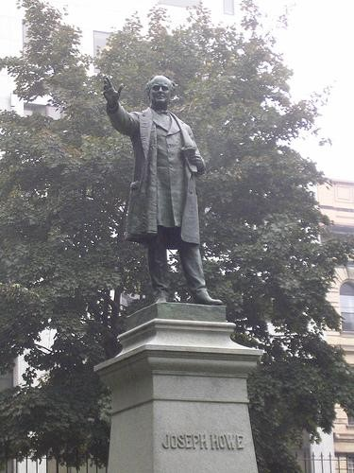
· Joseph Howe Case Study
Statue of Joseph Howe in
Downtown Halifax
→

Slide 11

· Since the people of BNA were having
trouble getting responsible government, many decided to turn against the government in a violent way.
· This is called a rebellion.
· There were two rebellions in 1837:
• 1. Lower Canada
• 2. Upper Canada

Slide 12

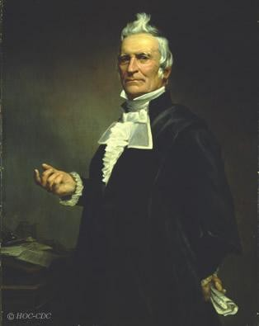
· Students need to know the biography of
Louis Joseph Papineau. He was the leader
of the Parti Patriote in Lower Canada.

Slide 13
The issues in Lower Canada were:
1. French were worried about losing their language and culture due to British control
2. Poor harvests → starvation
3. Cholera epidemic
4. New settlers would take all the land

Slide 14

· Students need to know the biography of
William Lyon Mackenzie (leader of the
reformers in Upper Canada).
The
1.
2.
issues in Upper Canada were:
How tax money was being spent.
Only the elite got the largest and
best
land – not fair
3.
Many farm families were facing
starvation.

Slide 15

· The issues in Upper and Lower Canada
continued, so they began to get angry.
· Lower Canada started a rebellion on Nov.
23, 1837. The Patriotes fought against the
British, but were defeated due to few
weapons and little military training.

Slide 16
· The rebellion in Upper Canada started
one month later, Dec 1837. Mackenzie
(their leader) organized a militia to
protect Toronto.
· A militia is a group of citizens who are
not trained soldiers, but who act like
soldiers in times of trouble.
· They were also defeated by the British.

Slide 17
-. .."
-------
· This is an artist’s depiction of the hanging
of two political reformers. They were hanged for their participation in the rebellion in Upper Canada.

Slide 18
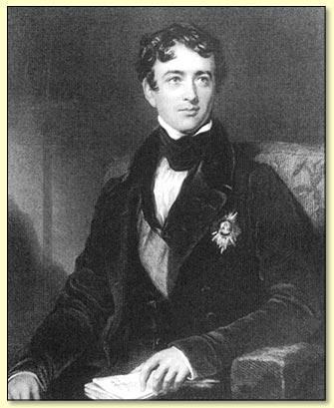
· The most important result of the
rebellions was that in 1838, the British government sent Lord Durham to BNA to investigate the situation and decide what to do.

Slide 19
He made two important
recommendations:
1. Upper and Lower
Canada should join and become Province of Canada
2. Give them responsible government (which is what they wanted)
*The British government took Lord Durham’s FIRST piece of advice. They did NOT give BNA responsible government… yet.

Slide 20

· There was a change in British attitudes.
This was an important reason that they
gave the colonies responsible government. British government gave BNA: Trade Preference and Free Trade.

Slide 21
11
· Trade Preference means that products
sent to Britain from BNA were not taxed.
This meant that it was cheaper for BNA
and it gave them a big market for their products.

Slide 22

· Free Trade means that some items were
traded between Britain and BNA were not
taxed, but some were. If Britain wanted to buy an item, they could “shop around” to find it cheaper from another country. This means that they no longer needed to
have as much control over BNA.

Slide 23

· In order to achieve a functioning
government, they had to form political
parties, which are groups of people with
the same ideas about government that
work together.
· There were two main political parties:
· 1.
Reformers/Liberals: people who
wanted change
· 2.
Conservatives/Tories: people who
wanted things to stay the same

Slide 24
Province Date of Responsible Person/People
Government Responsible
1. Nova Scotia 1847 James Boyle-Uniacke
2. Province of Canada 1849 Louis Hipployte LaFontaine (East) Robert Baldwin (West)
3. PEI 1851 George Coles
4. New Brunswick 1854 Charles Fisher
5. Newfoundland 1855 Philip F. Little

