Slide 1
Chapter 2
Economies in History

Slide 2
Important Terms For Chapter 2
Industrial Economies
Pre-Industrial Economies
Time immemorial
Aboriginal
Inuit
Tree Line
First Nation
First Metis
Mukushan
Maritimes
Atlantic Canada
Private Ownership
Migratory
Fishing room
Artifacts
Contact
Covenant chain of Treaties
Treaties of Peace and Friendship
Treaty
Beothuck

Slide 3
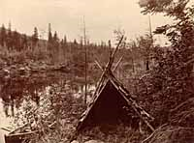
First Nation and Inuit Peoples of Newfoundland
The First Nation and Inuit peoples have lived in North America since time immemorial: for as long as anyone can remember in all stories passed on by elders.

Slide 4
Pre-Industrail First Nations
Pre-contact Mi'kmaq were a hunting-gathering people who were well-adapted to the natural world. They knew how to hunt, fish, and harvest their own food, how to build their own shelters, make their own clothes, and manufacture a wide variety of tools, weapons, and other implements. Extensive knowledge of the natural world was essential to Mi'kmaq survival. They had to time their hunting strategies around the migratory and spawning habits of fish, mammals, and seabirds, and to recognize which plants were edible, which were poisonous, and when they would be in season.

Slide 5
Prehistoric Mi'kmaq were skilled at making their own clothing, dwellings, transportation, weapons, tools, and other implements using the raw materials they harvested from the physical environment. They built tents out of wooden poles, which they covered with birch bark sewn together with spruce roots. Summer tents were typically conical in shape, while winter tents were wider and longer. Fir boughs, animal furs, and woven reed mats served as floor coverings, while a central fireplace provided warmth and light.

Slide 6
Women made a variety of clothing out of animal skins, which they sewed together with caribou sinew and bone needles or awls. Summer attire generally consisted of skin leggings, sleeves, moccasins, and either a loincloth for men or a frock for women. Fur robes and hooded parkas provided extra warmth in the winter. Mi'kmaq people sometimes decorated their clothing with shells, porcupine quills, and dyes made from red and yellow ochre, charcoal, and ground-up shells (which produced a white dye).

Slide 7
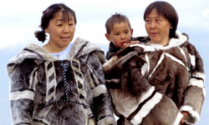
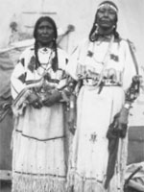
Women made a variety of clothing out of animal skins, which they sewed together with caribou sinew and bone needles or awls. Summer attire generally consisted of skin leggings, sleeves, moccasins, and either a loincloth for men or a frock for women. Fur robes and hooded parkas provided extra warmth in the winter. Mi'kmaq people sometimes decorated their clothing with shells, porcupine quills, and dyes made from red and yellow ochre, charcoal, and ground-up shells (which produced a white dye).

Slide 8
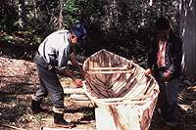
Pre-contact Mi'kmaq built canoes using cedar frames and birch-bark shells. These vessels were of varying lengths (typically between 5.5 and 8.5 metres) and resilience – some could make only short voyages along rivers and lakes, while others were sea-going vessels able to cross long distances carrying entire families and their possessions. For winter travel, the Mi'kmaq made snowshoes out of wooden frames and animal-hide webbing. They also used hand-drawn toboggans to transport heavy loads over the snow.

Slide 9
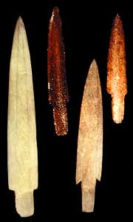
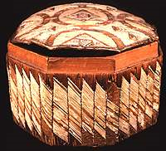
The Mi'kmaq manufactured weapons, tools, containers, and many other items out of wood, bone, bark, antler, and other naturally occurring materials. They made hooks and needles from bone; projectile points from stone and bone; containers and pots from birch bark; kettles from wood; and baskets from grass. Like other prehistoric peoples, the Mi'kmaq had extensive knowledge of the physical world and were inventive in their use of natural resources. Everything they ate, wore, lived in, and used came from their surroundings.

Slide 10
Three Groups of Aboriginal Peoples in Canada today
1. The Inuit: the First Peoples of the region north of the tree line (where the climate is too cold for trees to grow) and in parts of what are now Quebec and Labrador. The Quebec Inuit and Labrador Inuit are two examples of Inuit
2 . First Nations are the First Peoples of the rest of the land that is now Canada. There are many First nations, Including the Mi’kmag
3. The Metis were the children of either Inuit or First Nations women and European traders. The metis today are descendants of these people, or they may define themselves as Metis because of their distinct culture and traditions.

Slide 11
Distribution of Goods
In most First nations and Inuit communities everyone helped with production, and everyone shared equally in what was produced.
First nations and Inuit also had a trade network, using this trade network people were able to help one another when some struggled to survive.
There was no private ownership of land; they believed that no one could own land.

Slide 12
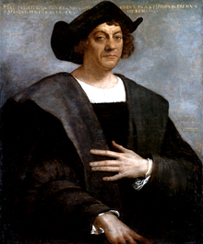
Newcomers
It is a commonly held belief by archaeologists and the rest of the world alike that the indigenous people of North America have resided on this continent for at least 15,000 years. These Native Americans were by and large nomadic groups who belonged to many different tribes, developed similar cultural and religious beliefs, and tended to live in concert with nature though not necessarily in complete harmony with each other. As the popular pneumonic device teaches us..."In 1492, Columbus sailed the ocean blue," when Columbus did make this most famous voyage he stumbled upon the realm of the Native Americans and history has since credited the Spanish reconnoiter with the discovery of the New World.

Slide 13
Why did Europeans Leave their Homelands?
Wanted to own more land, looking for land to take over.
Believed in spreading their culture and their religion
Private land ownership
Natural resources, to sell back in Europe

Slide 14
Three Key resources
Fish
Furs
Timber

Slide 15
European Production and distribution
Production
Distribution
Making tools by hand
Most things made in the home
Jobs done with the help of animals
Individuals specialized in made a good and then sold it to those who could not
Dressmakers
Bakers
weavers
The most common way for goods to be distributed was through amarkets. In other words, if you wanted something, you paid for it with money.
If you had something you didn’t need you could sell it

Slide 16
The Impact of contact
Contact: is the term used to refer to the time when Europeans first came to North America
When the First Nations of the Maritimes first met Europeans, First Nations were curious about the newcomers and willing to see what they were all about. The Newcomers did not know how to survive in this land so they badly needed the help the First Nations offered
This was the beginning of the fur trade, the Europeans wanted furs and the first nations wanted goods such as knives and pots.

Slide 17
Treaties
A treaty is an agreement between two or more nations. A treaty may be made for any number of reasons, such as to settle a war or agree on economic issues. A treaty sets out the nations’ rights and responsibilities and is meant to be honour and respected.
There had been some conflicts between First Nations, and the Europeans from the beginning of Contact.
The French also become involved fighting Britain for new in the New World.
Between 1717 and 1779 Great Britain and First Nations entered into a number of treaties to solve their problems.

Slide 18
Purpose of treaties
Each treaty was different but the main idea of the treaties was that First Nations agreed to act peacefully toward the British and the British agreed to respect First Nations rights.
First Nations did not agree to give up land or natural resources to Britian.
These treaties are still in force today, and they apply to the First Nations today/

Slide 19
Effects of the Fur Trade
People spent more time hunting fur bearing animals such as fox and bears
People had to use more European goods because they spent more time hunting for furs
The number of fur animals went down.
When they had no furs the First Nations people did not have anyway to get the things they wanted

Slide 20
The effects of European Settlement
The idea of private land ownership created problems,
As forest were cleared for farming there was less land for hunting and fishing
The newcomers were taking over rivers, lakes, and oceanfront areas that provided food sources.
The Europeans believed that their economic, political, and cultural ideas were superior to first nations ideas.

